Slide 1



Vertical Slice Architecture
Jimmy Bogard
@jbogard
github.com/jbogard
jimmybogard.com

Slide 2

History Lesson

Slide 3
Traditional n-tier
UI Layer
Business Logic Layer
Data Access Layer
Database

Slide 4
“DDD”-style n-tier
UI Layer
Domain Objects
Repository
Database

Slide 5
Organizing by layer
Person.cs
PersonController.cs
PersonService.cs
PersonRepository.cs

Slide 6
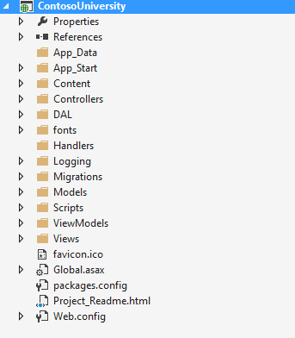
Areas of change

Slide 7
Vertical Slice Architecture Model and organize application architecture around axes of change, vertical slices

Slide 8
Vertical Slices

Slide 9
Move code to single place

Slide 10
Move service methods to classes
Invoice Service
void Approve()
ApproveInvoice {}
void Reject()
RejectInvoice {}
void Flag()
FlagInvoice {}

Slide 11
Modeling requests
Input
Request Handler
Output

Slide 12
Request/Response with MediatR
IRequest<T>
IRequest
Handler<T>
T
Task<T> Handle(
IRequest request) {
}

Slide 13
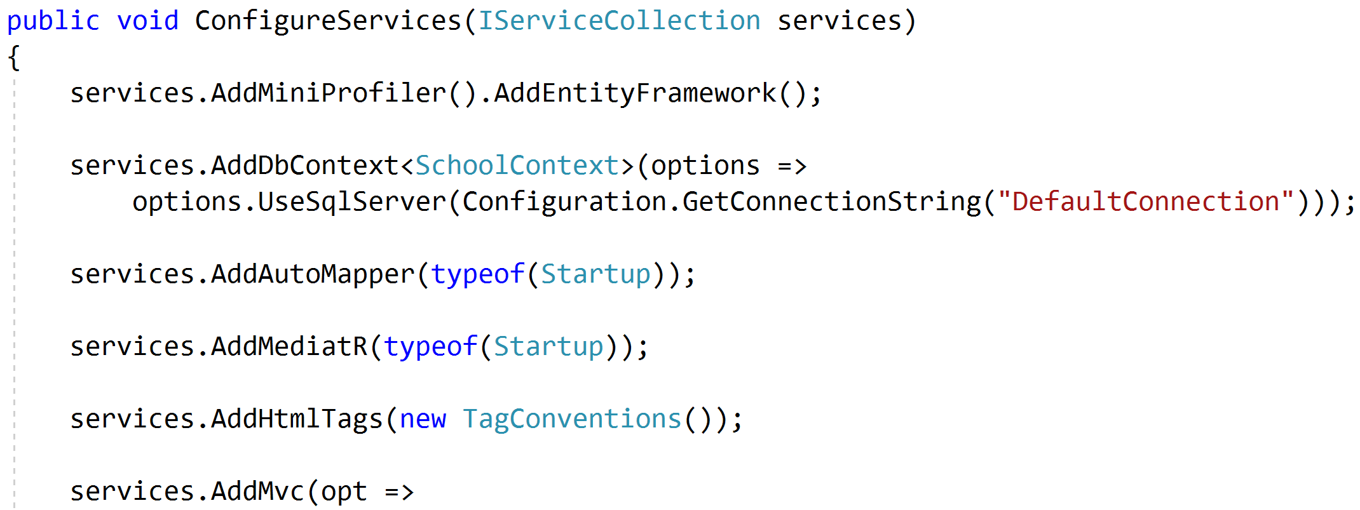
Registering MediatR

Slide 14
Commands and Queries
Web App
GET
Query
Handler
Response
Query
POST
Command
Handler
Response
Command

Slide 15
One model in, one model out
Query
Handler
Response
Command
Handler
Response

Slide 16
Complete encapsulation
Request
Response

Slide 17
Modeling Queries
Query
Handler
Response

Slide 18
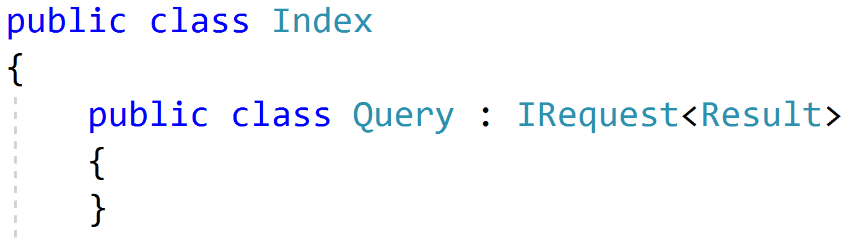
Simple Queries

Slide 19
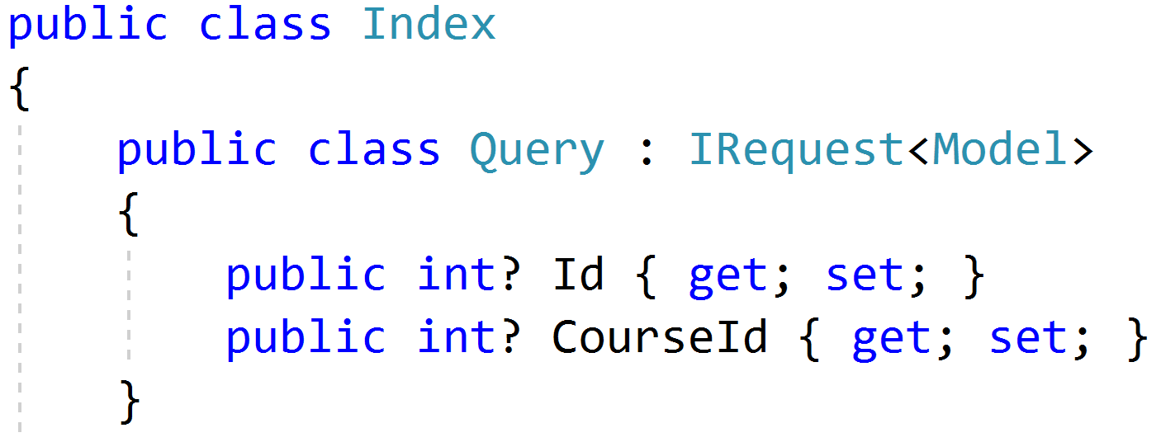
Parameterized Queries

Slide 20
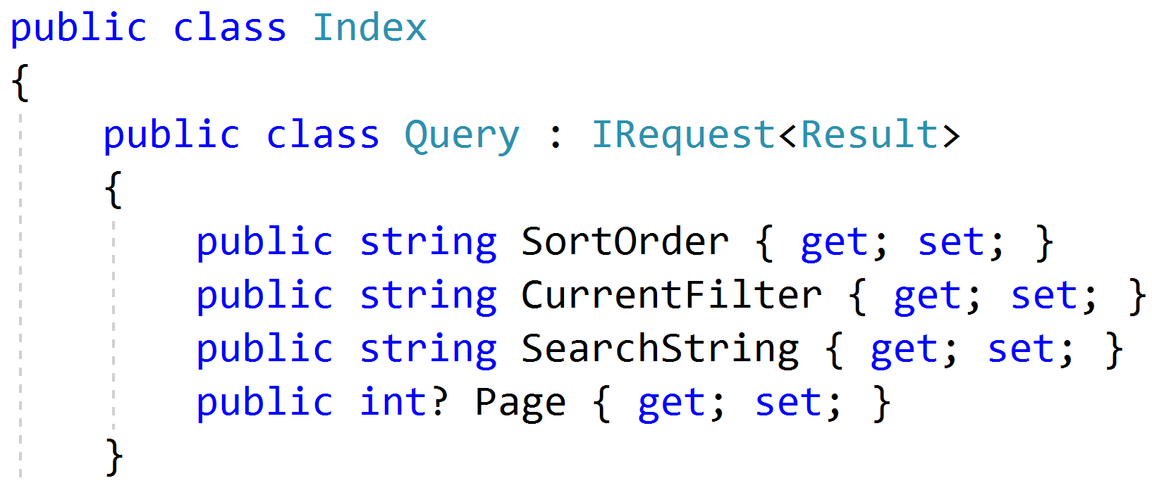
Paging/Sorting/Filtering

Slide 21
Modeling Responses
Query
Handler
Response
View

Slide 22
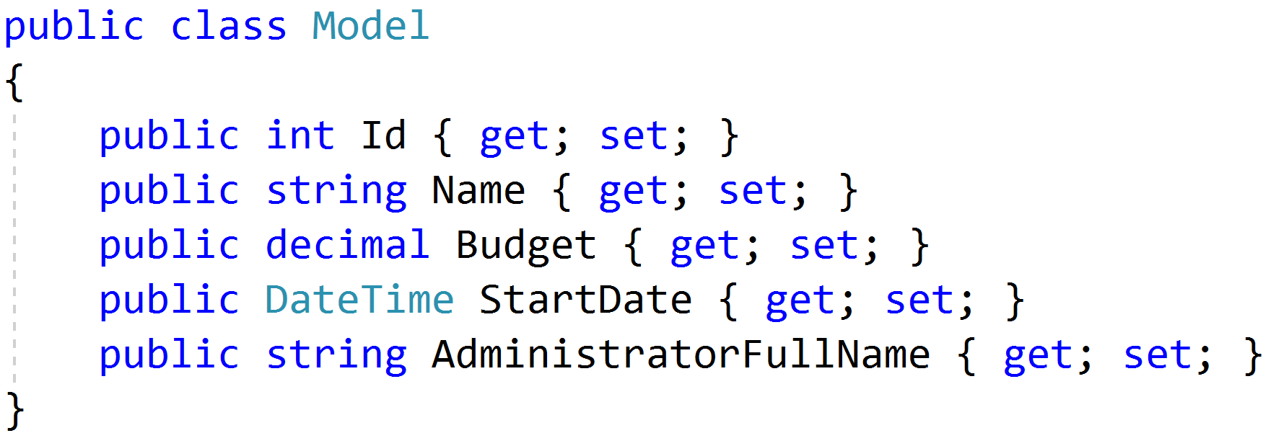
Simple Response

Slide 23
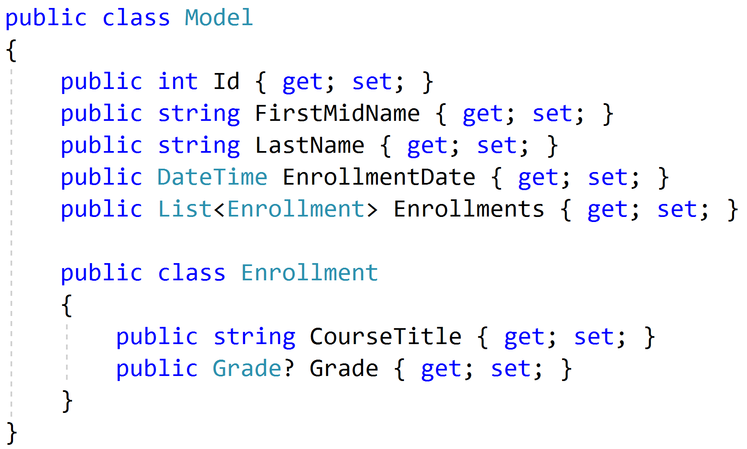
Complex Response

Slide 24
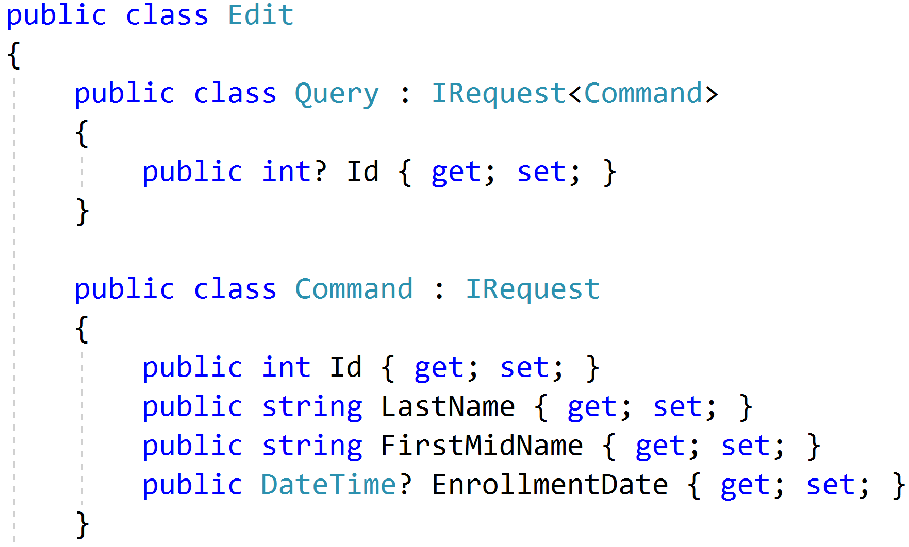
Command/Query Duality

Slide 25
Modeling Commands
Command
Handler
Response

Slide 26
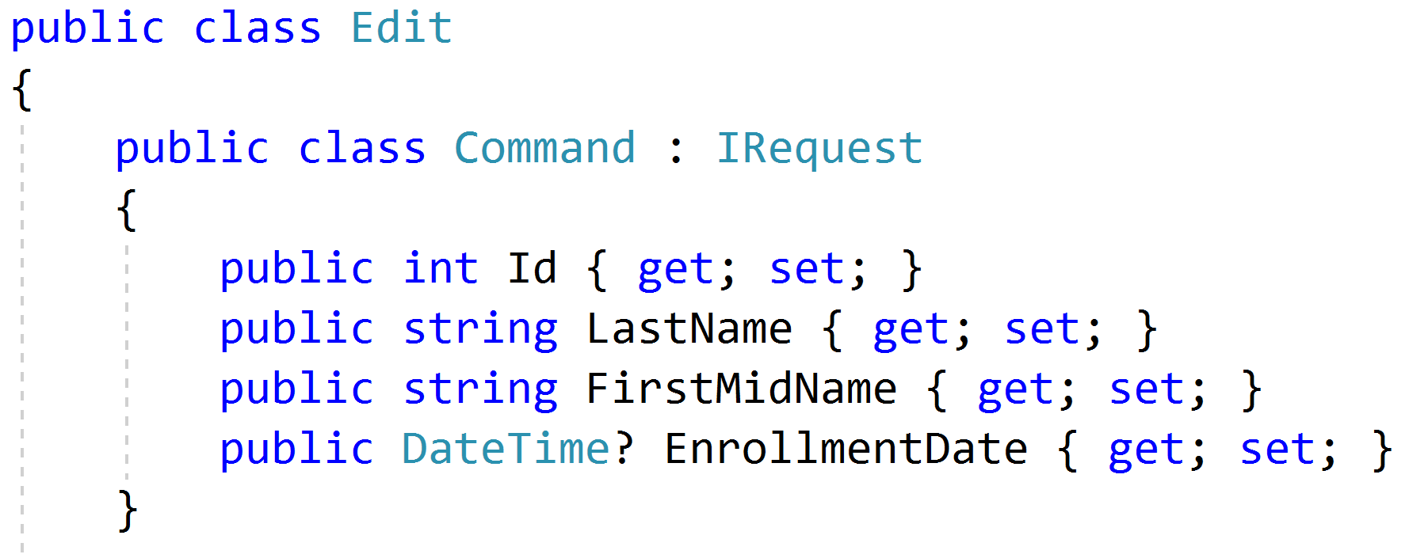
Simple Commands

Slide 27
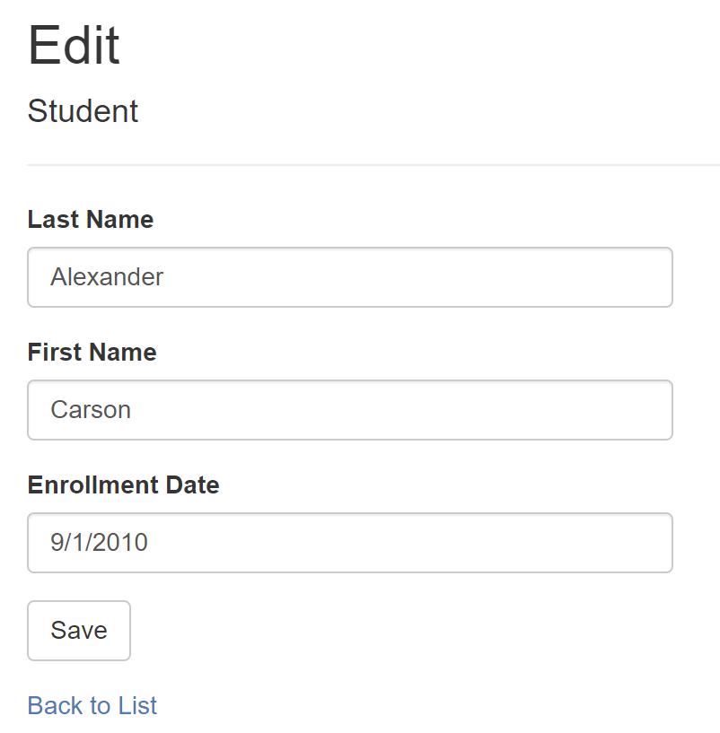
Model-Bound Types

Slide 28
Task-Based UIs
Transfer
Student Details
Request
Handler
Response
Transfer
Correct
Schedule
…
…
…
…
…
…
…
Correct
Request
Handler
Response
Schedule
Request
Handler
Response

Slide 29
Modeling Command Responses
Command
Handler
Response

Slide 30
Void Response
Command
Handler
IRequest

Slide 31
Command Result Response
Command
Handler
T
IRequest<T>

Slide 32
Success/Fail
Command
Handler
true/
false
IRequest<bool>

Slide 33
Creation
Create
Handler
Id
IRequest<Guid>
302 Found
/orders/081bcba7-89ff-4a41-af90-ded095160b99

Slide 34
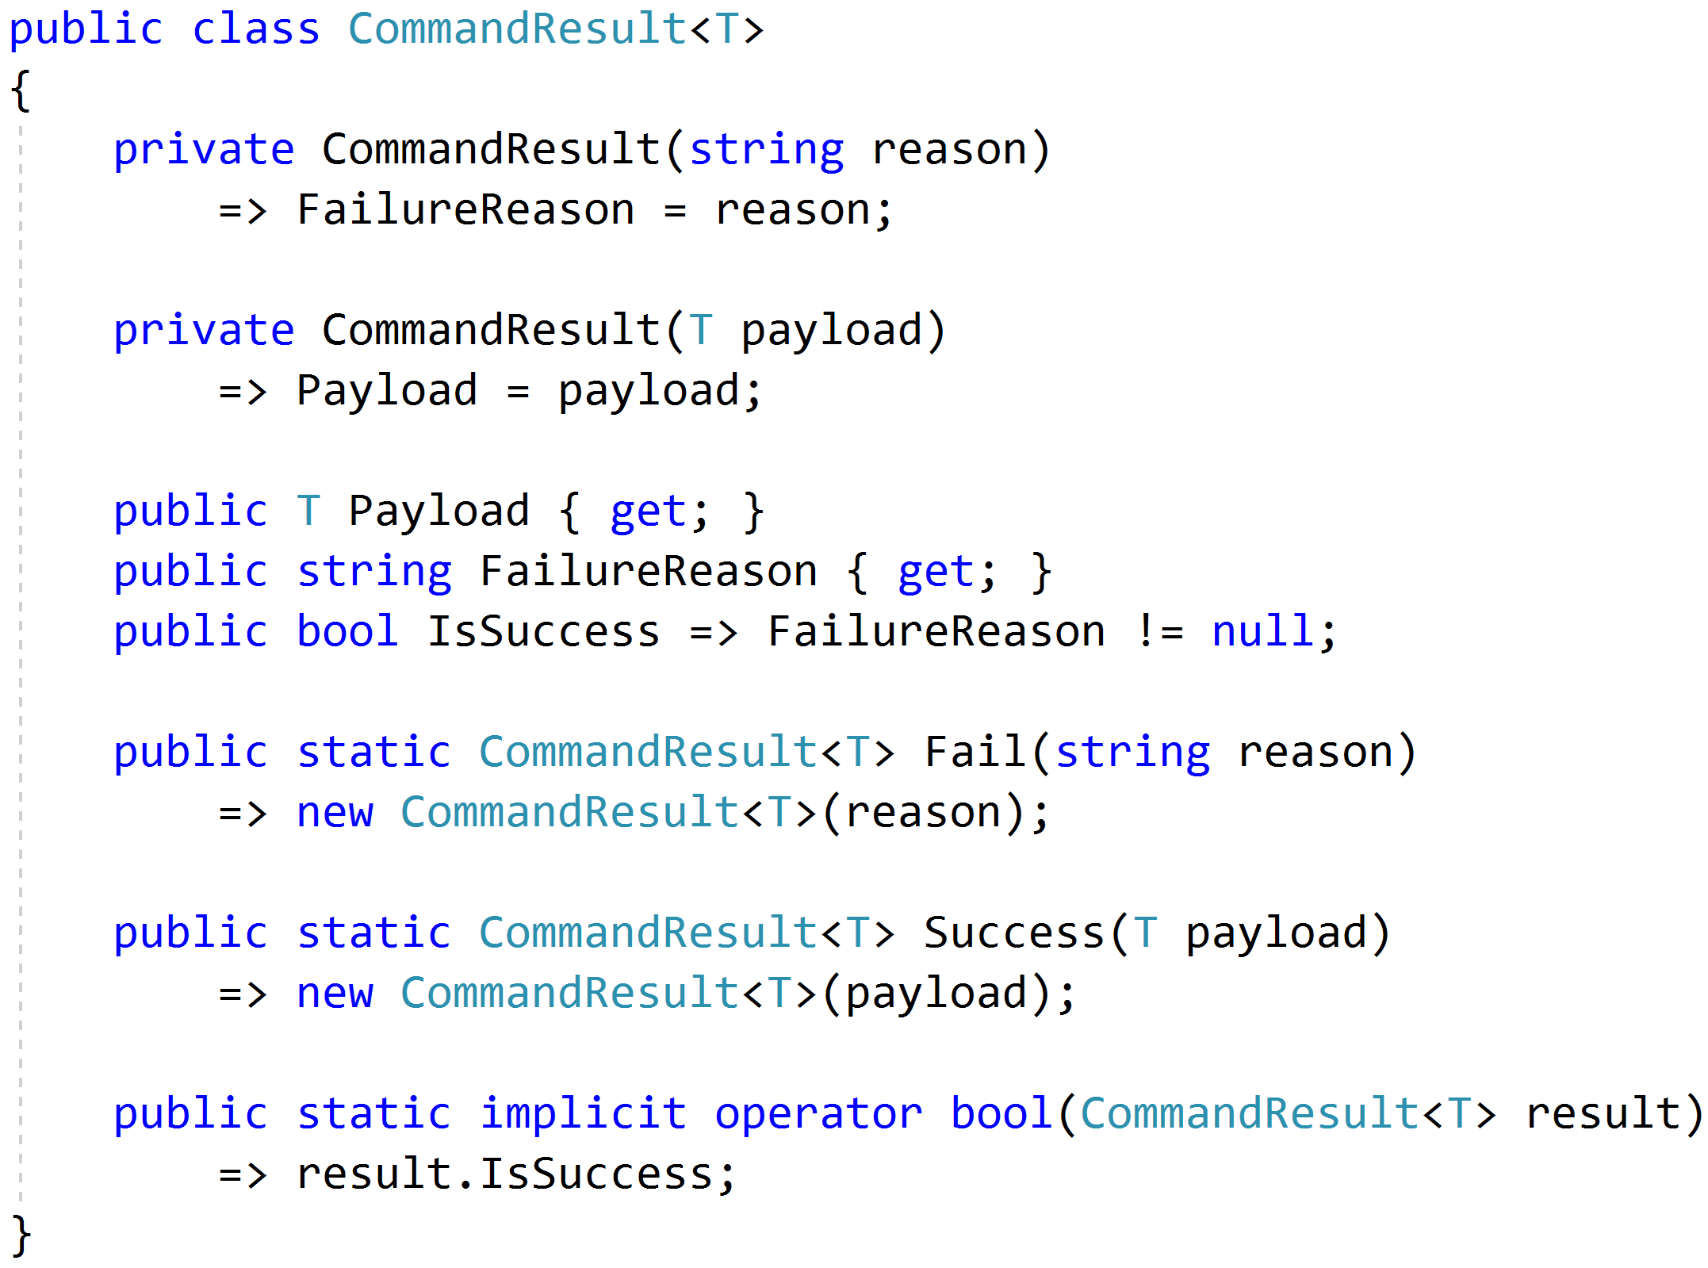
Complex Response

Slide 35
Modeling Query Handlers
Query
Handler
Response

Slide 36
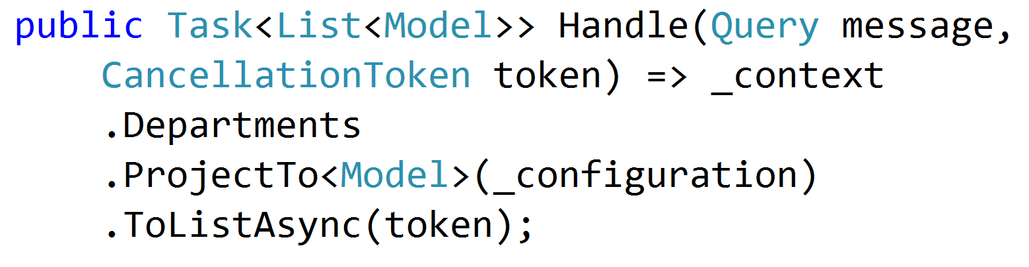
Simple AutoMapper Projections

Slide 37
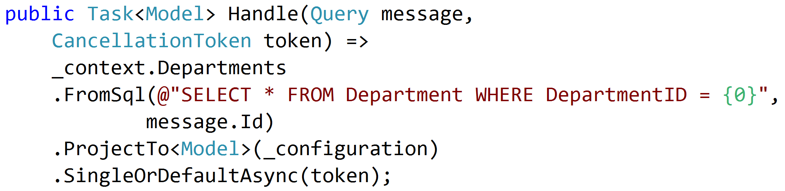
SQL Projections

Slide 38
Encapsulated Logic
Query
EF Core
Response
Query
Dapper
Response
Query
HttpClient
Response
Query
MeatGrinder
Response

Slide 39
Duplicate Logic
Query
Handler
Response
Common
Query
Handler
Response
Common

Slide 40
Refactor
Query
Handler
Response
Class?
Function?
Extension Method?
Common
Query
Handler
Response

Slide 41
Command Handlers
Command
Handler
Response

Slide 42
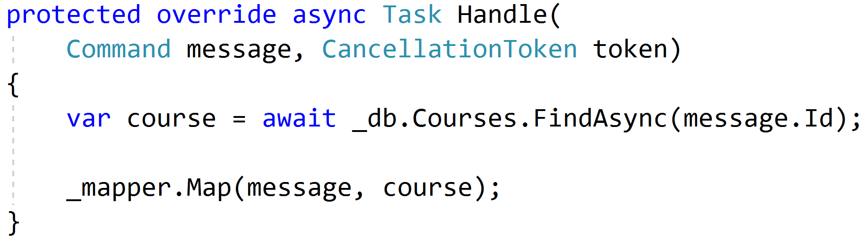
Procedural Beginnings

Slide 43
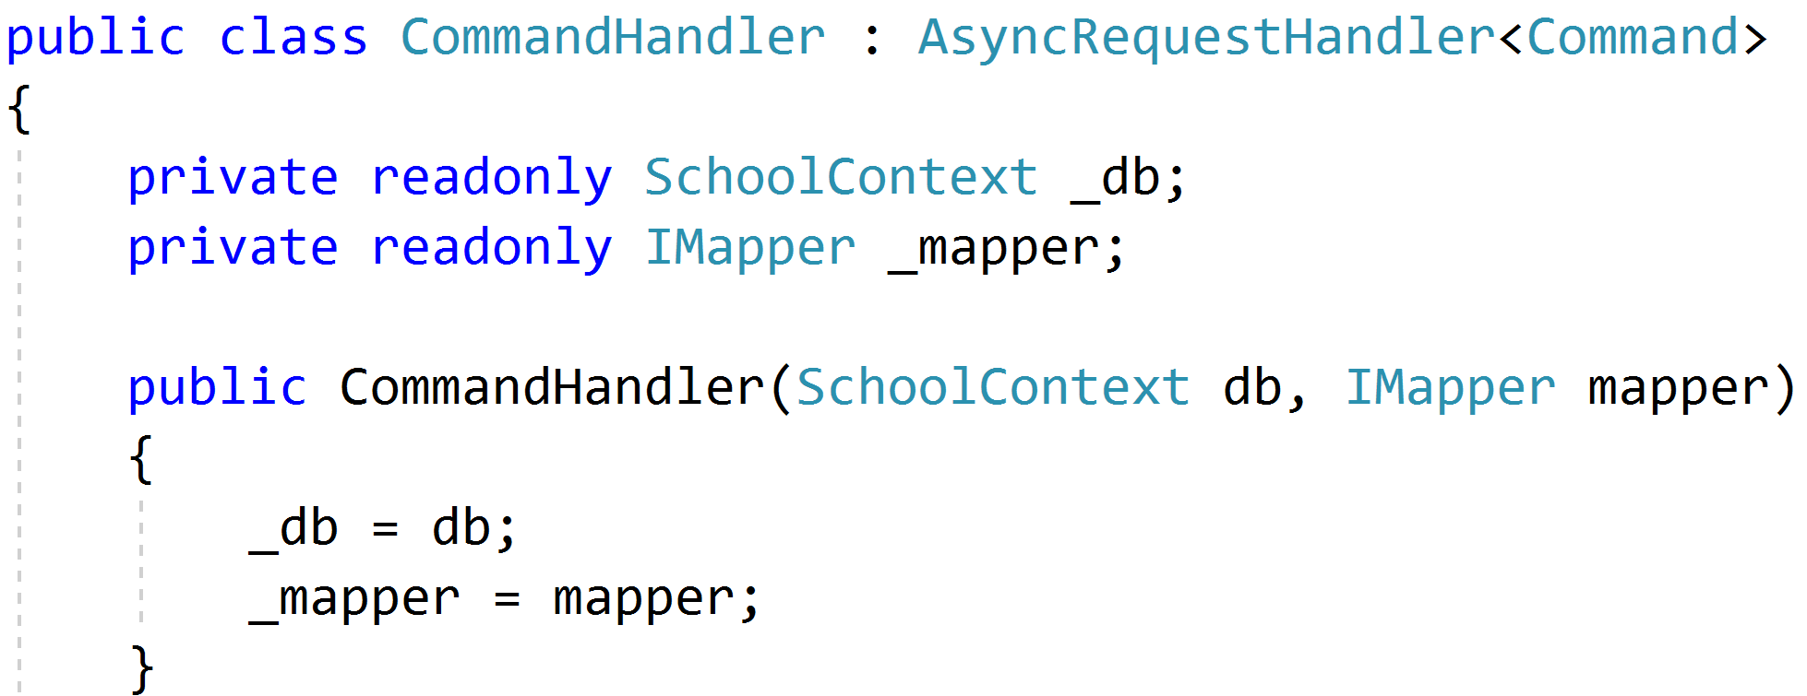
DI with no abstractions

Slide 44
Complexity?

Slide 45
Don't Panic!

Slide 46
Red
Green
Refactor

Slide 47

Code Smells
Large Class
Extract Class
Extract Subclass
Extract Interface
Extract Method
Replace Method
with Method Object
Compose Method
Long Method

Slide 48

Behavioral Smells
Combinatorial Explosion
Conditional Complexity
Feature Envy
Inappropriate Intimacy
Duplicated Code

Slide 49
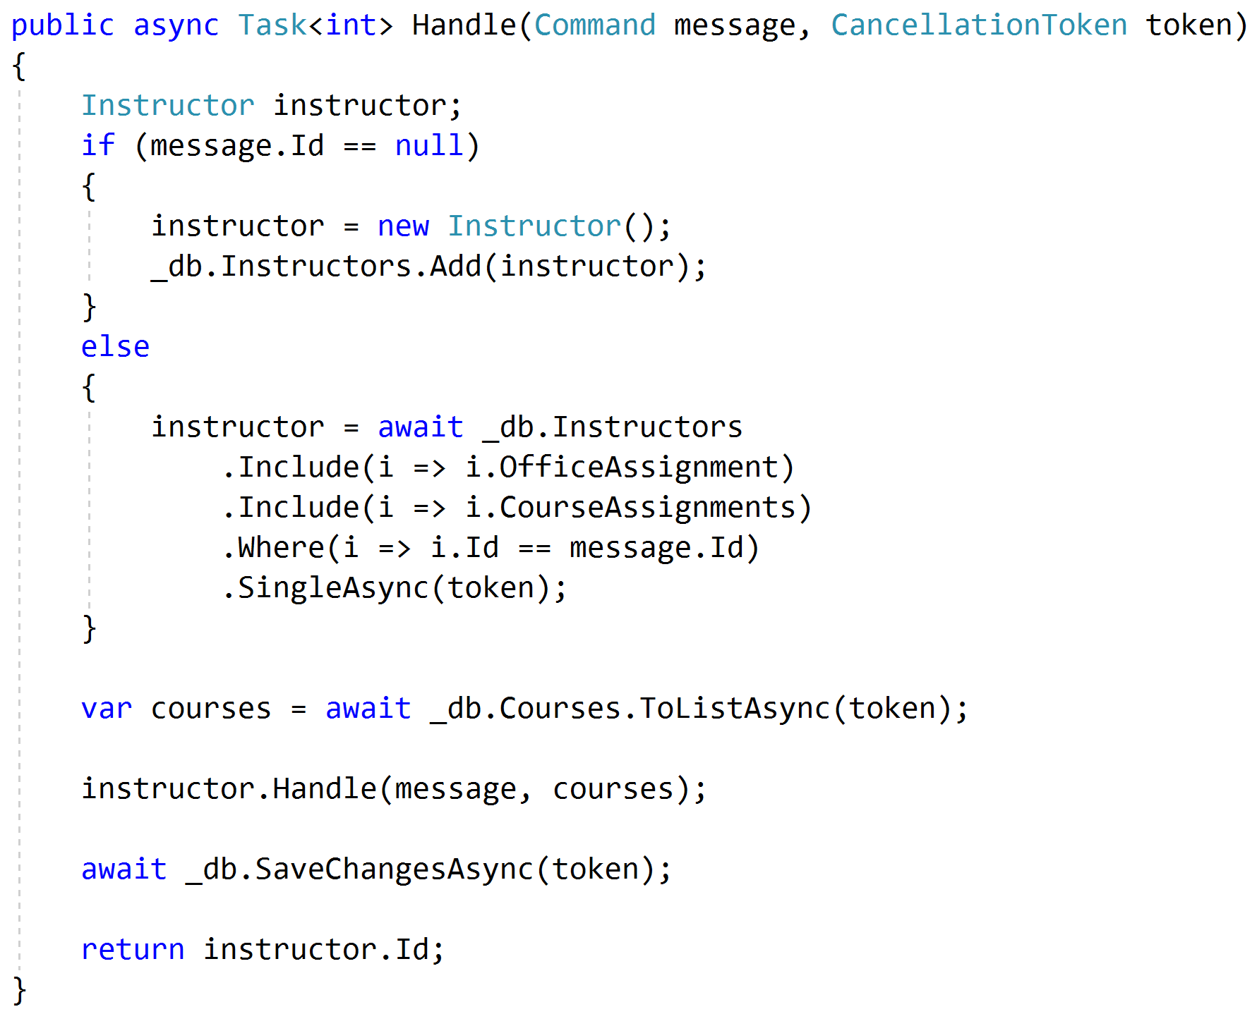
Push Behavior Down
Request
Handler
Domain
Response

Slide 50
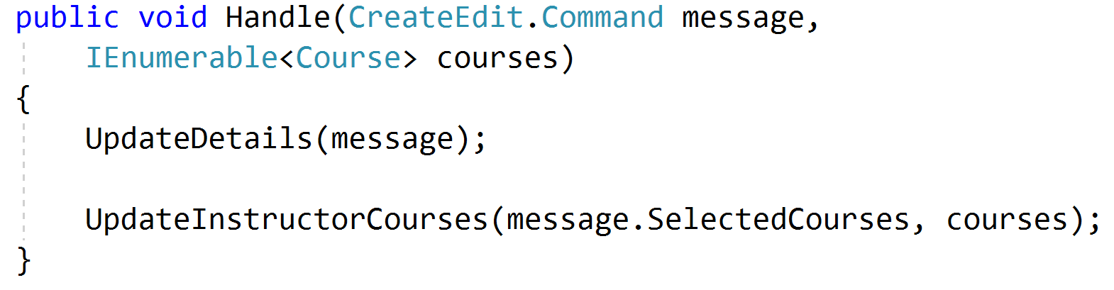
Encapsulated Domain
Request
Handler
Domain
Response

Slide 51
Validation?

Slide 52
Validation Scopes
Command Validation
Domain Model
Request Validation
Request
Database
External Models

Slide 53
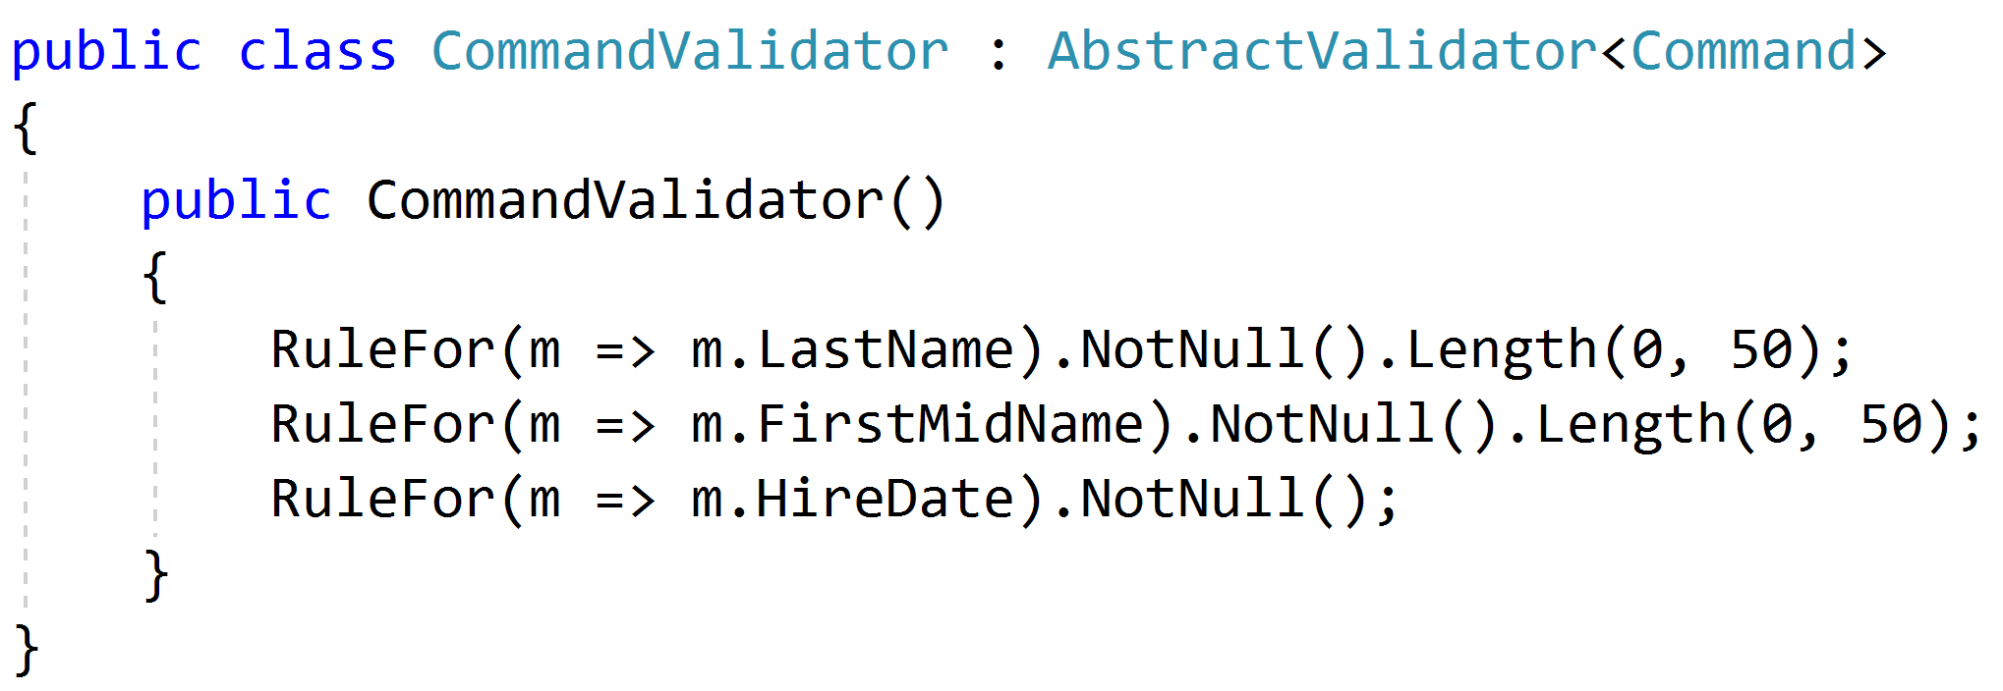
Request Validation

Slide 54
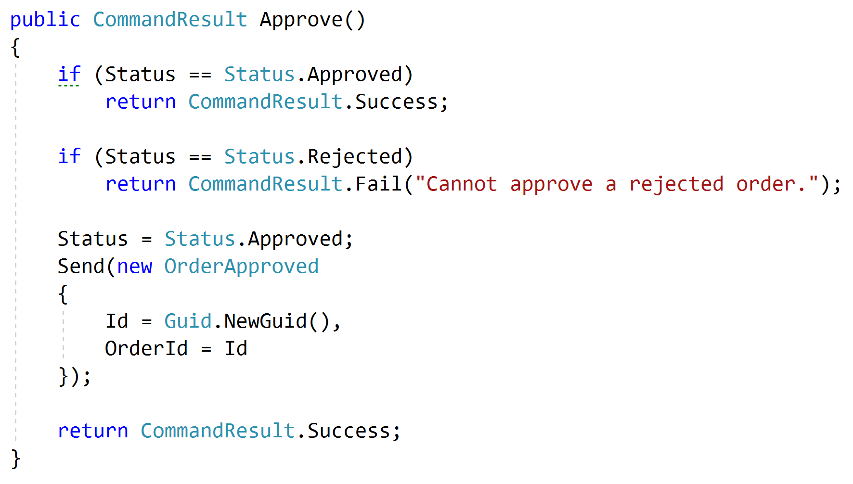
Domain Validation
Request
Handler
Domain + Validation
Response

Slide 55
Representations
Query
Handler
Response
????

Slide 56
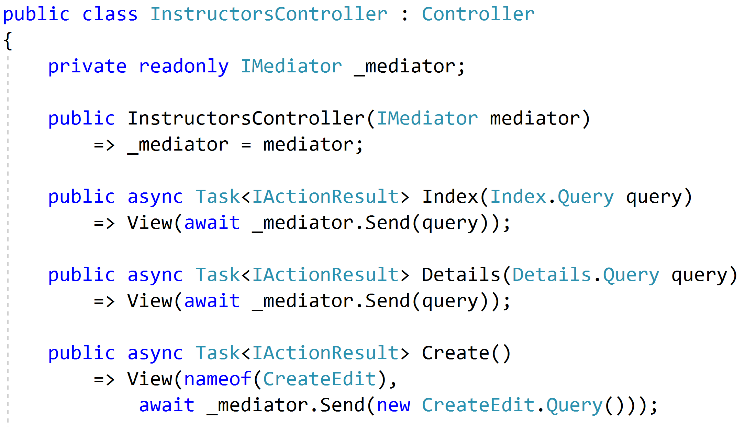
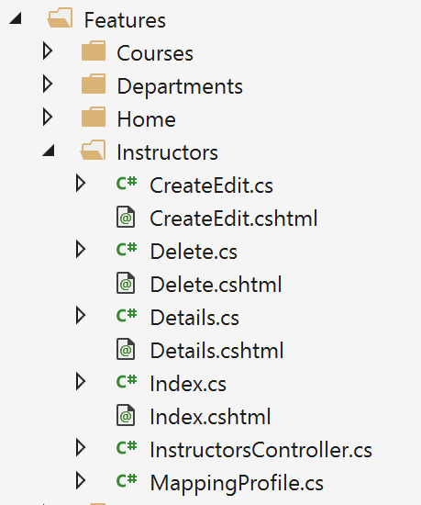
Controllers as routes

Slide 57
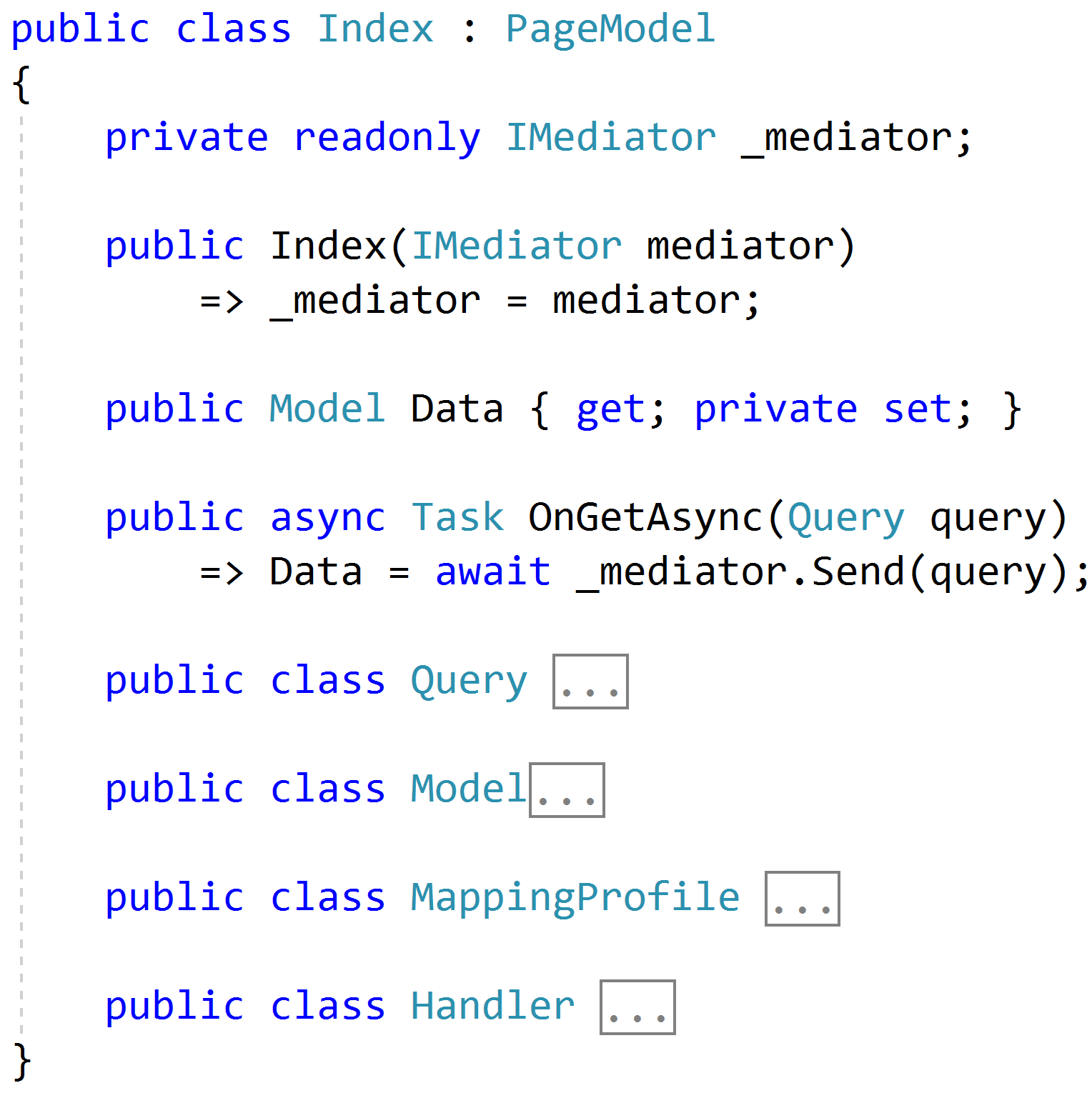
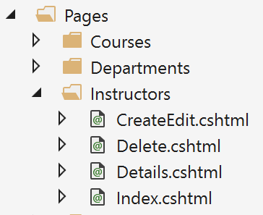
Razor Pages

Slide 58
Web APIs
/order/approve
Handler
/order/reject
Handler
Order json
/order/hold
Handler
/order/cancel
Handler
SPA

Slide 59
Cross-Cutting Concerns
Duplication
Request
Handler
Response

Slide 60
Pipeline Behavior (Decorator)
Pipeline Behavior
Request
Handler
Response

Slide 61
Stackable Decorators
Pipeline Behavior
Pipeline Behavior
Pipeline Behavior
Handler

Slide 62
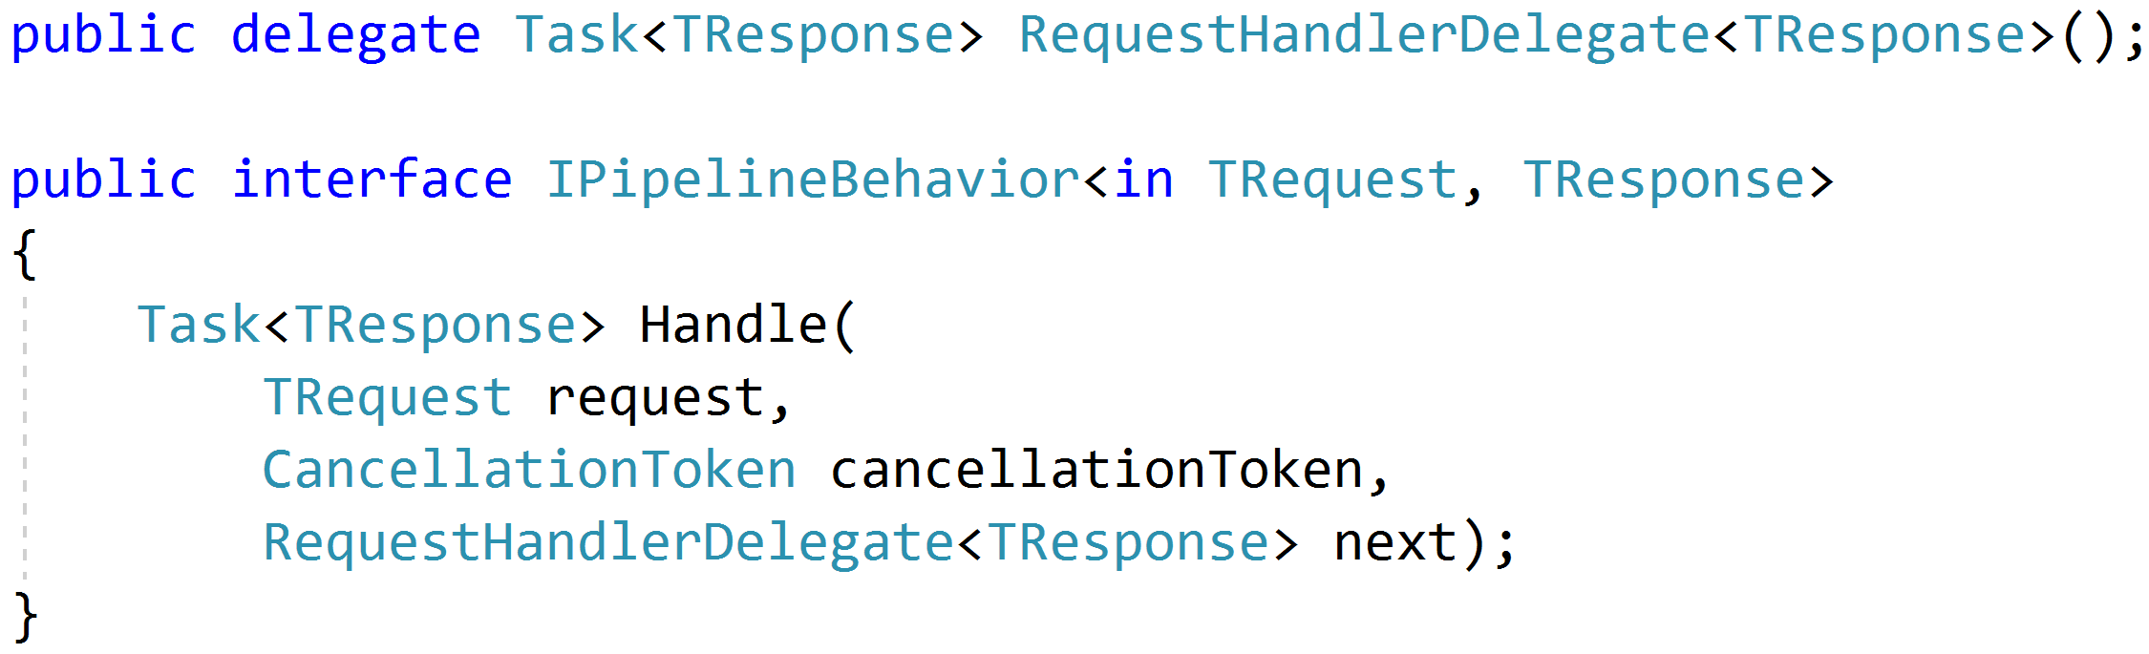
Think: Action Filters

Slide 63
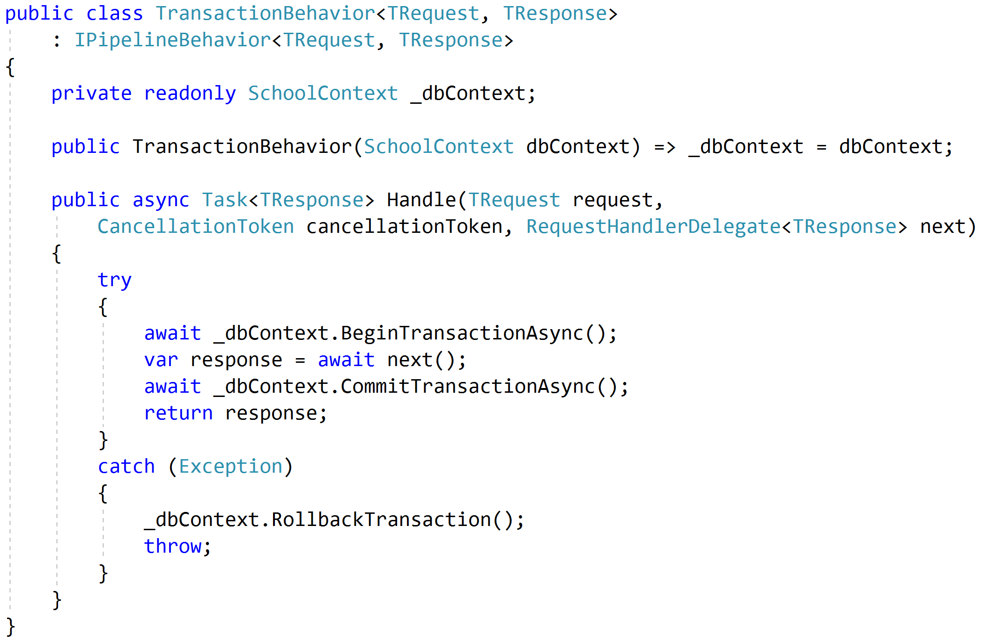
Transactions

Slide 64
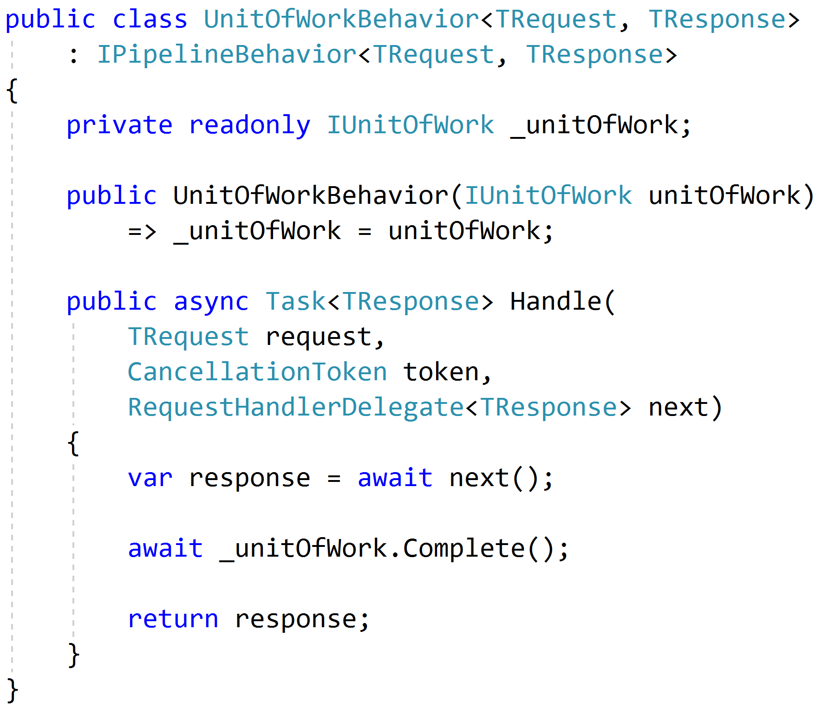
Unit of Work

Slide 65
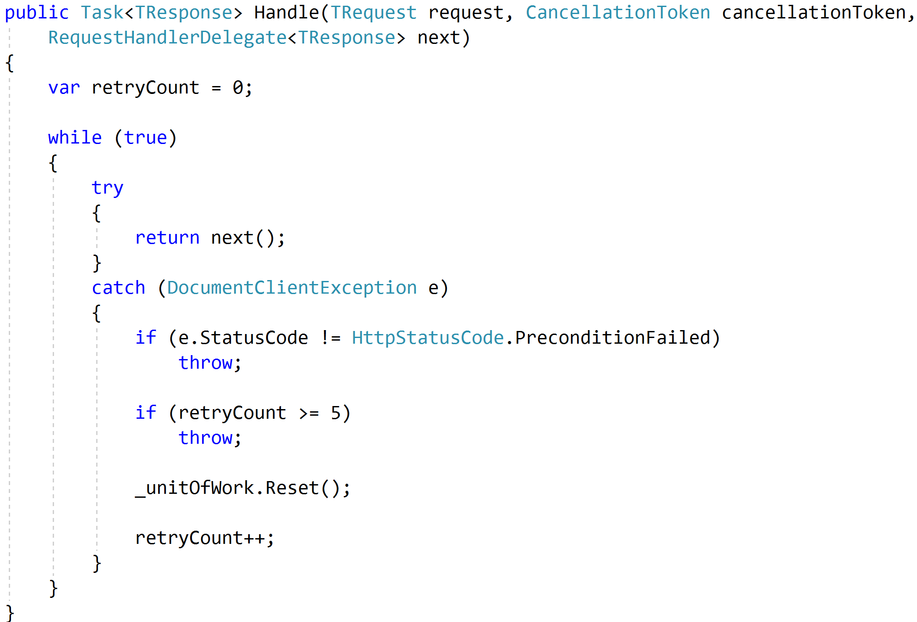
Concurrency and Retries

Slide 66
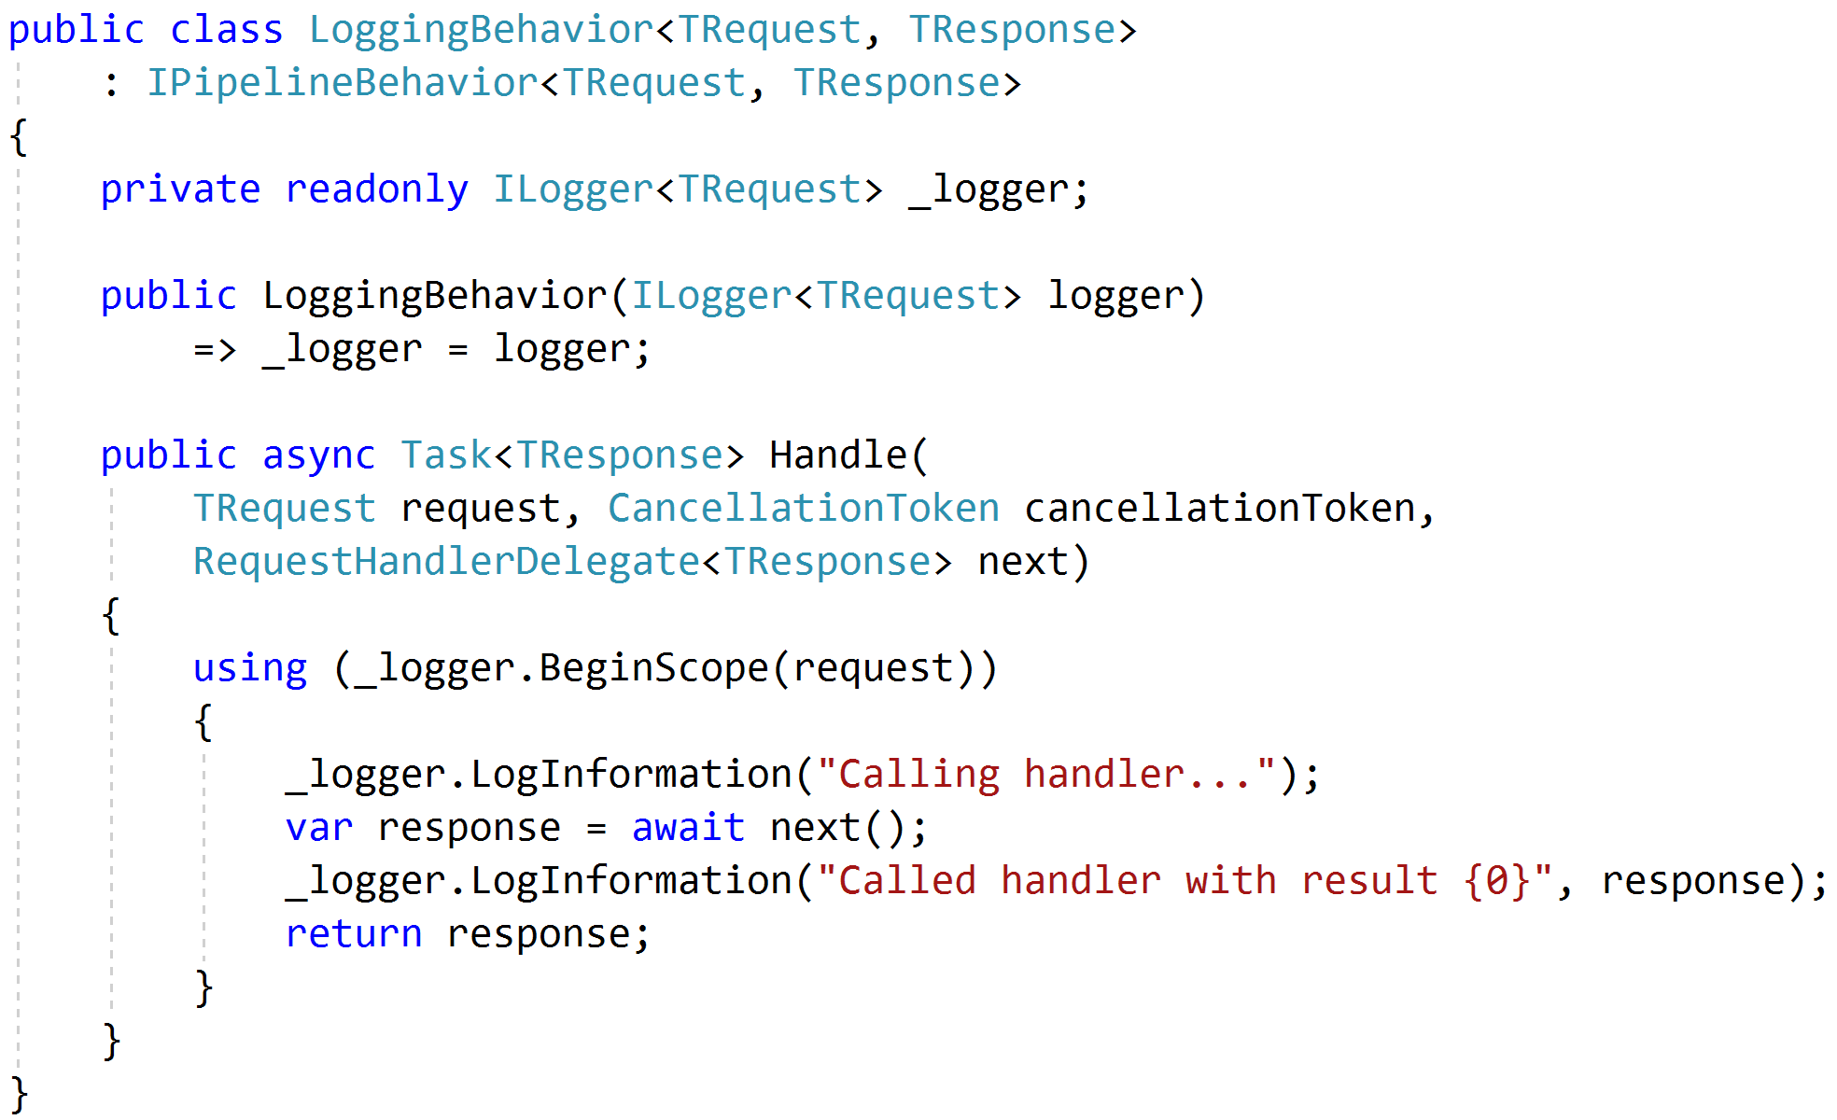
Logging

Slide 67
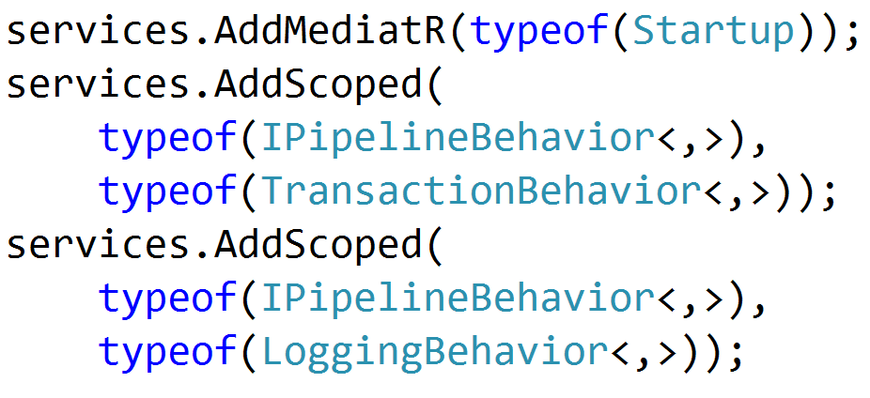

Registration

Slide 68
Testing
Pipeline Behavior
Pipeline Behavior
Pipeline Behavior
Request
Handler
Response
Arrange
Assert
Act

Slide 69
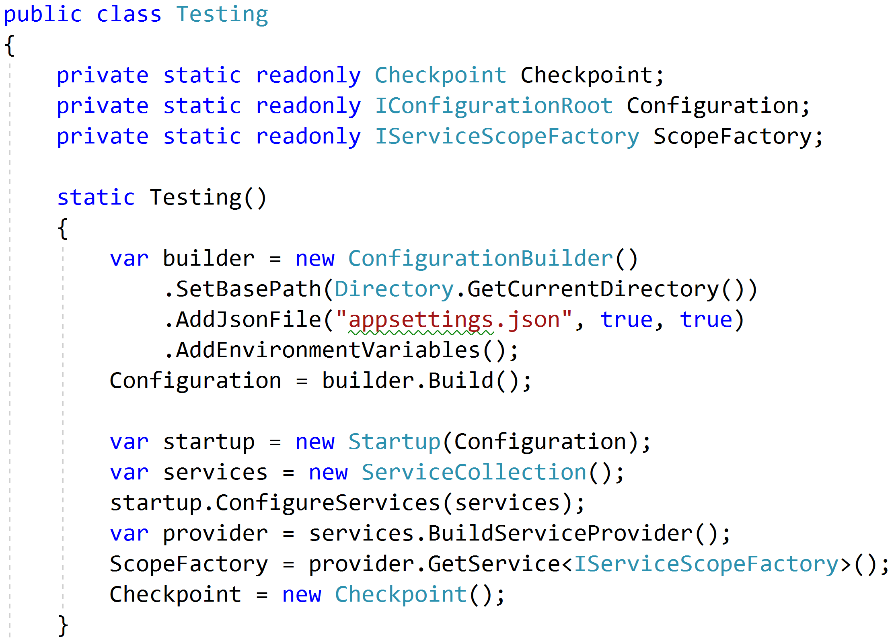
Reproduce Reality

Slide 70
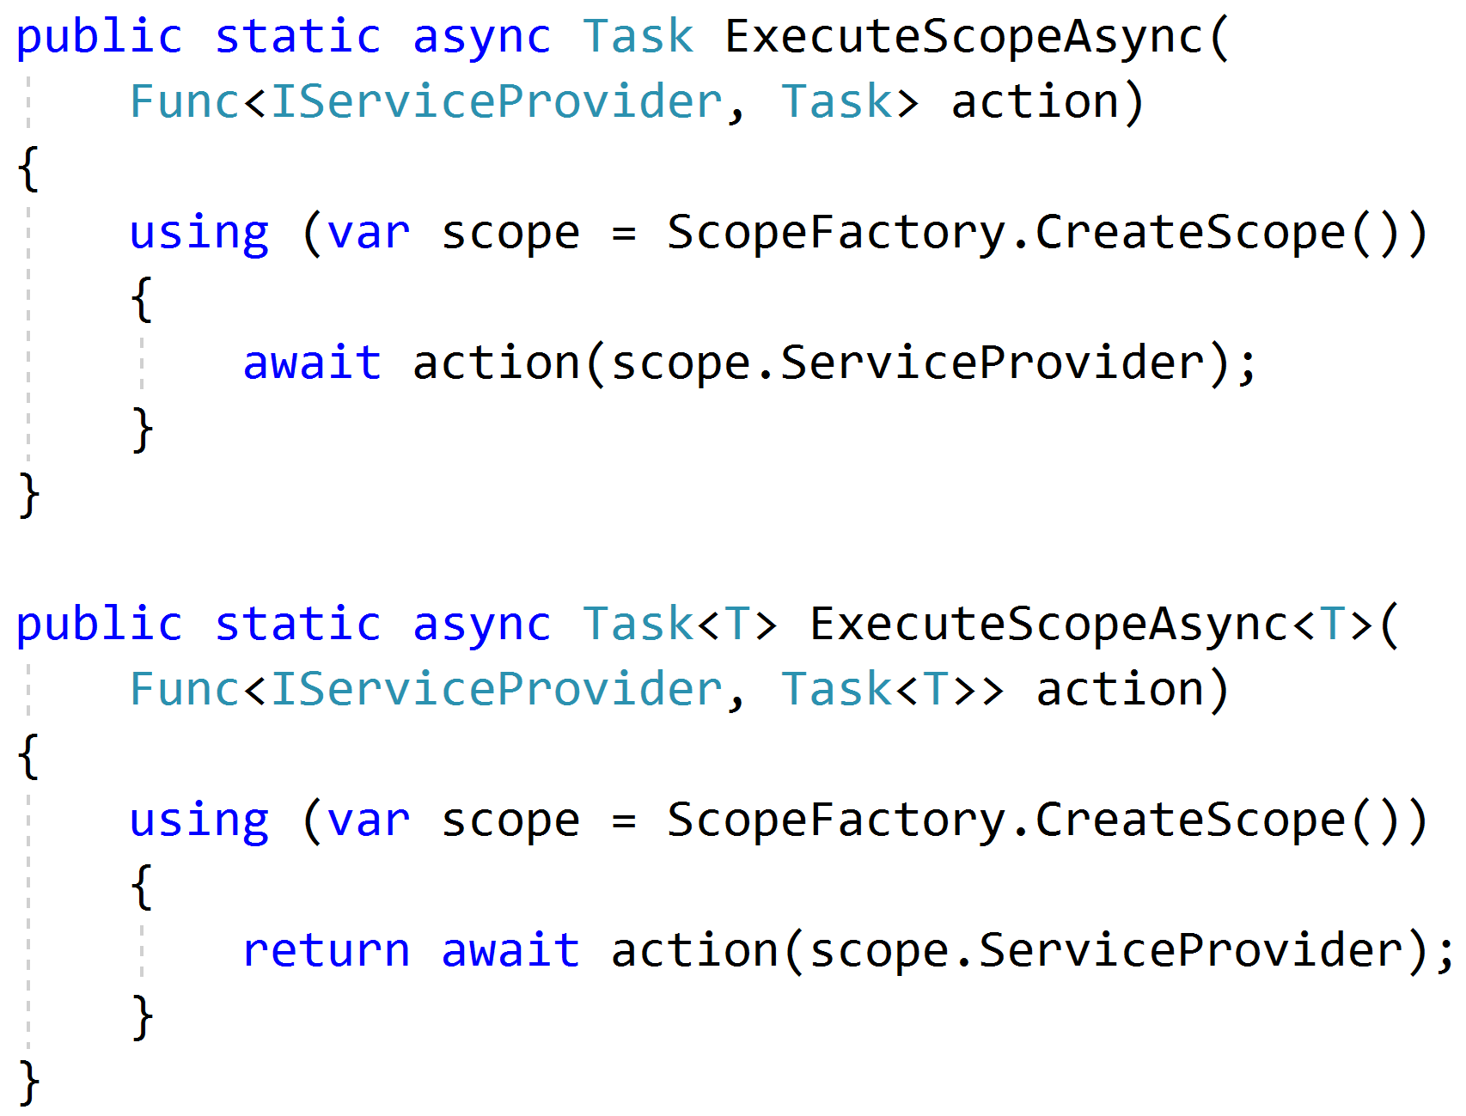
Mimicking Scoped Requests

Slide 71
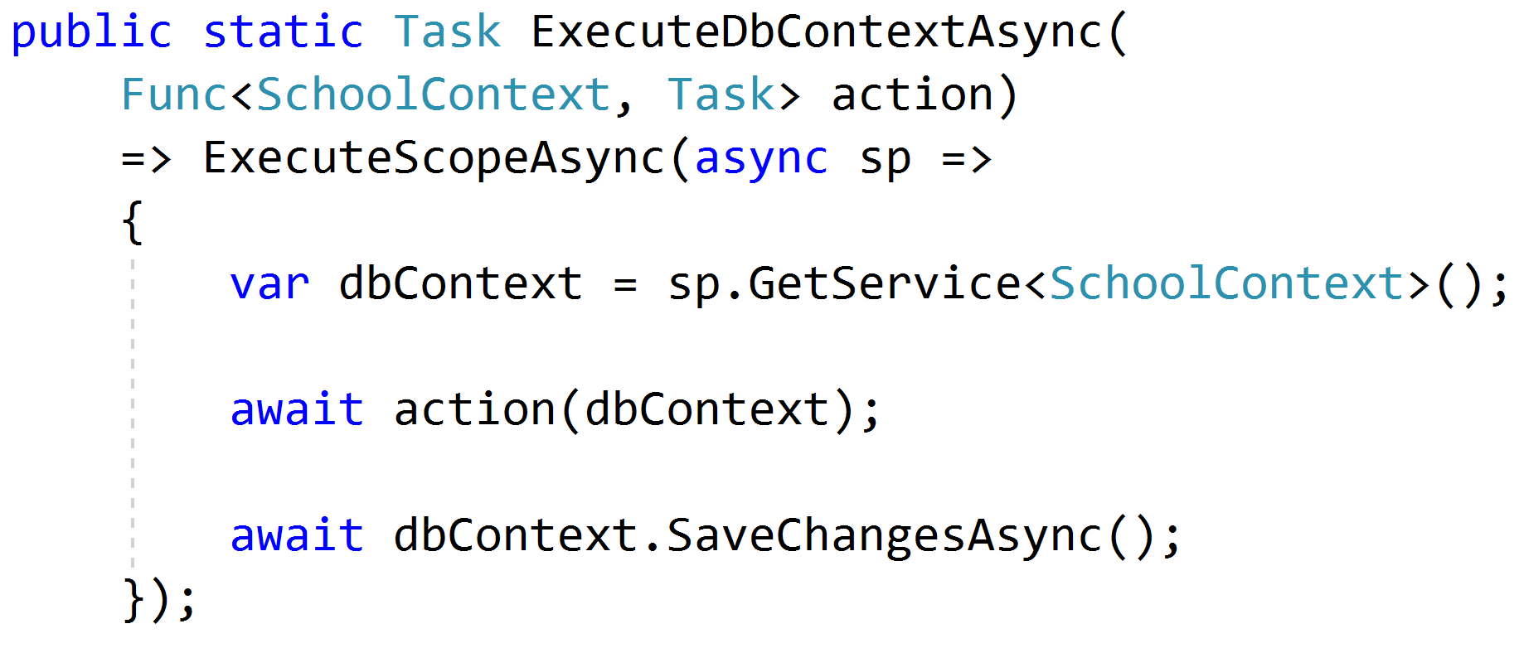
Setting Up Data

Slide 72
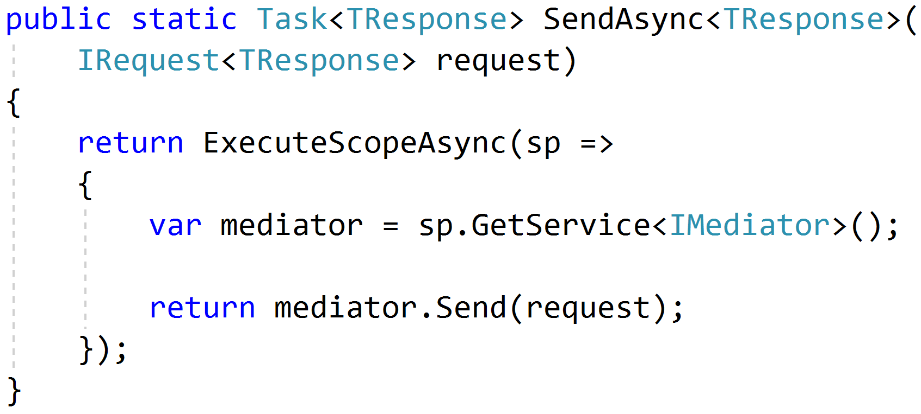
Sending Requests

Slide 73
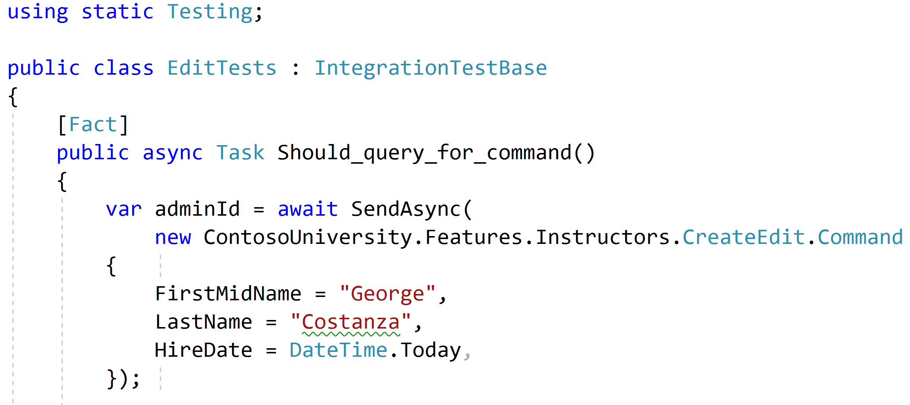
Using static helpers

Slide 74
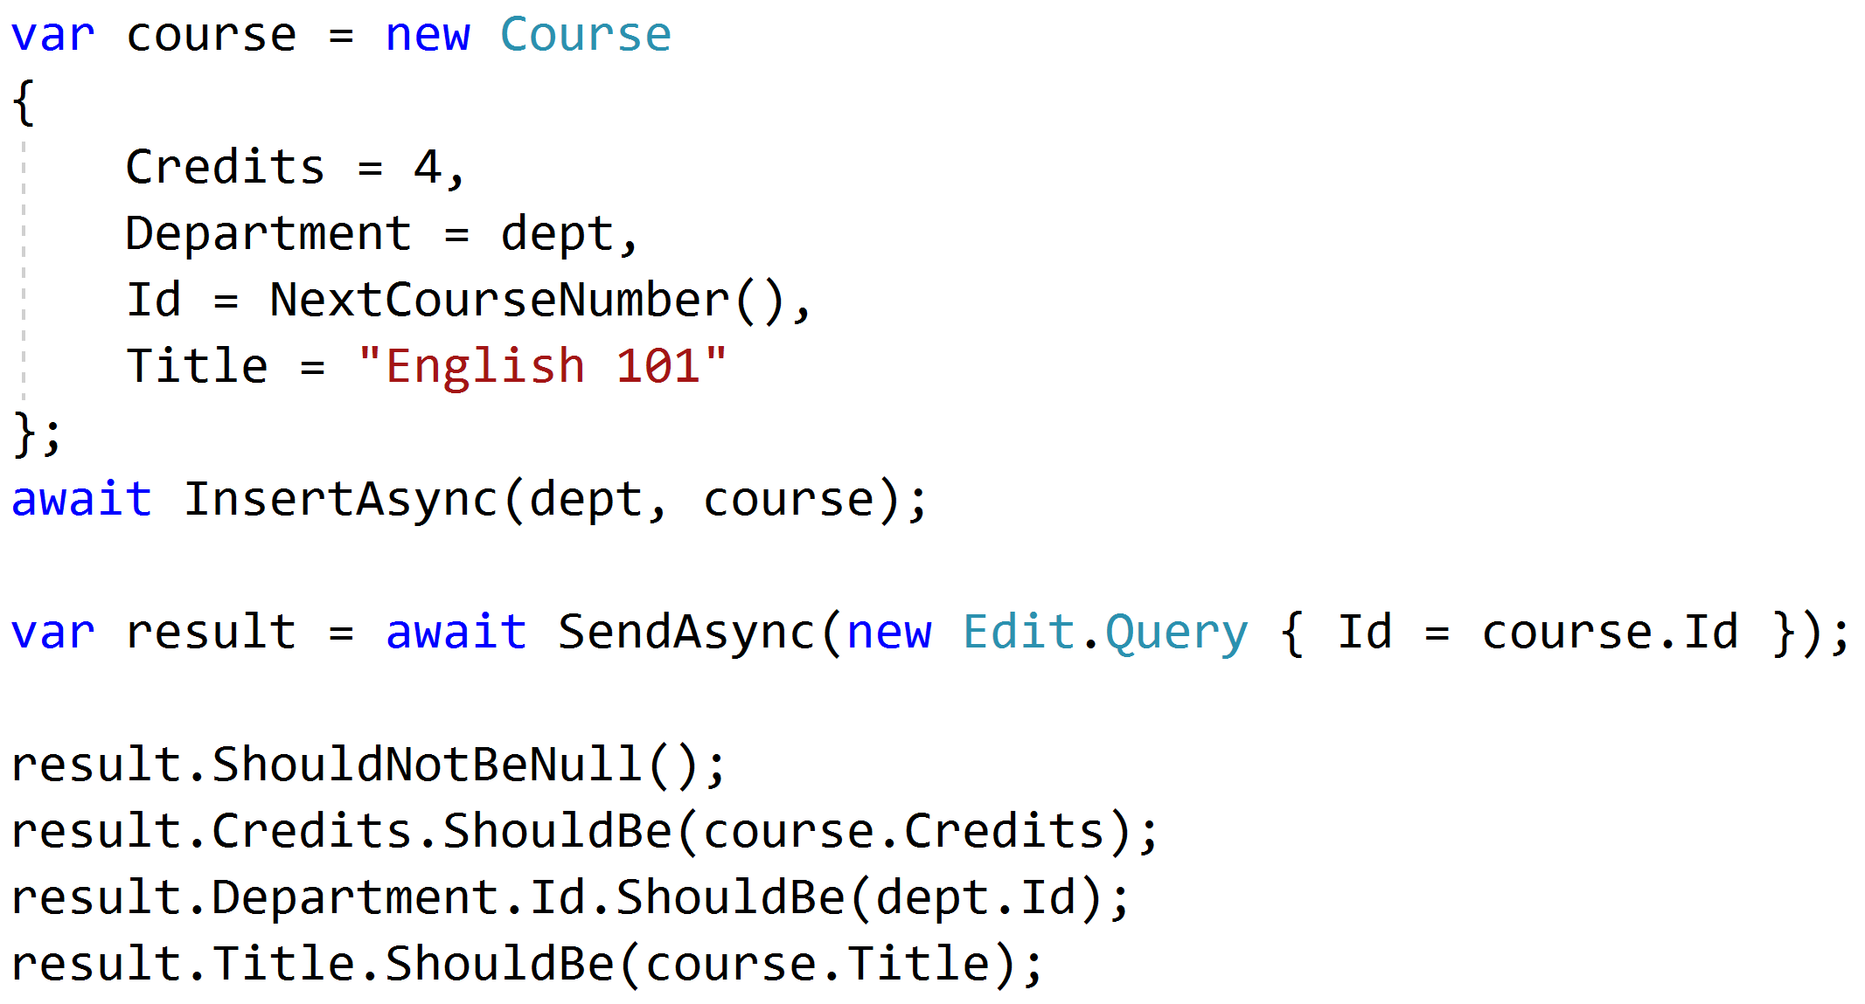
Testing queries through result

Slide 75
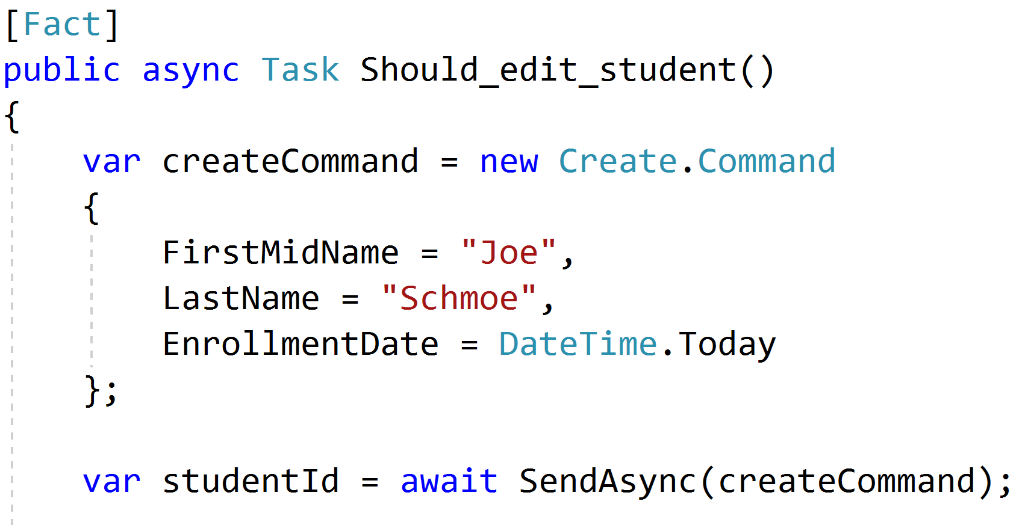
Setup through the front door

Slide 76
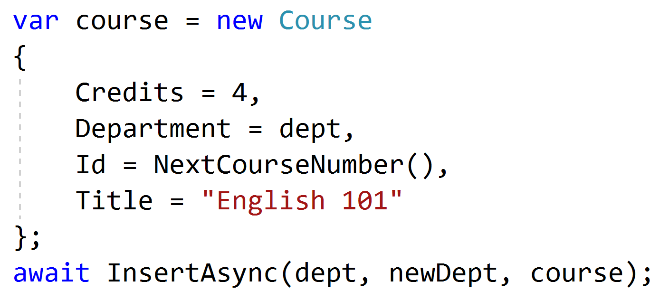
Setup data directly when needed

Slide 77
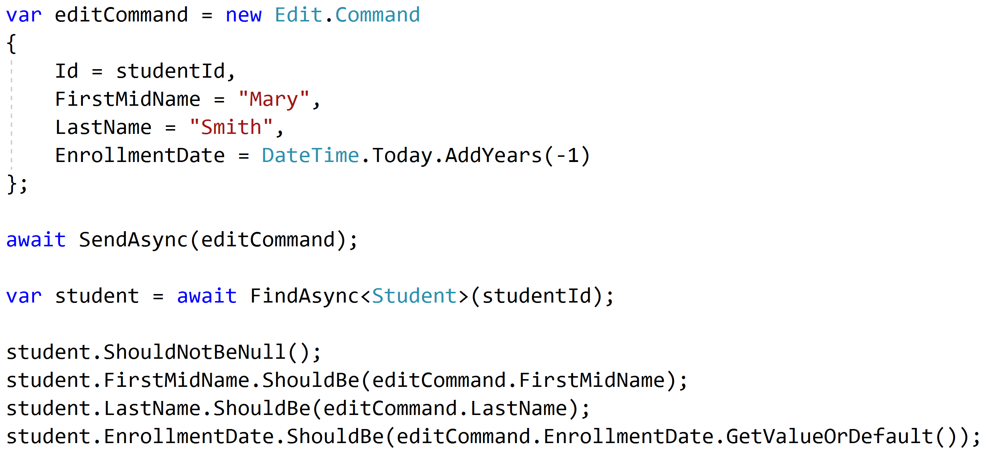
Test commands with roundtrips

Slide 78
Unit and Integration Tests
Pipeline Behavior
Integration Tests
Pipeline Behavior
Pipeline Behavior
Handler
Rich Domain Model
Unit Tests

Slide 79
Key Takeaways
Vertical slices makes code easy to add/change/delete
Do not skip refactor!
Push behavior down
Integration test handlers, unit test domain

Slide 80


Vertical Slice Architecture
Jimmy Bogard
@jbogard
github.com/jbogard/presentations
jimmybogard.com

